Slide 1
Vampire Attacks: Draining Life from Wireless Ad Hoc Sensor Networks

Slide 2
Outline
Introduction
Classification
Protocols and Assumptions
Overview
Related Work
Attacks on Stateless Protocols
Attacks on Stateful Protocols
Clean-Slate Sensor Network Routing
PLGP
Provable Security against Vampire Attacks
PLGPa
Performance Considerations
Conclusion

Slide 3
Introduction
As WSNs become more and more crucial to the everyday functioning of people and organizations, availability faults become less tolerable.
thus high availability of these networks is a critical property, and should hold even under malicious conditions.
Due to their ad hoc organization, wireless ad hoc networks are particularly vulnerable to denial of service (DoS) attacks,and a great deal of research has been done to enhance survivability
Existing schemes can prevent attacks on the short term availability of a network, they do not address attacks that affect long-term availability.
The most permanent denial of service attack is to entirely deplete nodes’ batteries. This is an instance of a resource depletion attack, with battery power as the resource of interest.
Paper considers Vampire Attacks, that drain the life from networks nodes. Characteristics:
Do not disrupt immediate availability, but rather work over time to entirely disable a network.
not protocol-specific
Existing secure routing protocols are vulnerable.
Authors stress that prior work has been mostly confined to other levels of the protocol stack, and they instead focus on routing-layer resource exhaustion attacks.

Slide 4
Introduction (cont’)
More Characteristics of Vampire Attacks:
Exploit general properties of protocol classes such as link-state, distance vector, source routing, and geographic and beacon routing.
These attacks do not rely on flooding the network with large amounts of data, but rather try to transmit as little data as possible to achieve the largest energy drain, preventing a rate limiting solution. Since Vampires use protocol-compliant messages, these attacks are very difficult to detect and prevent.
This paper makes three primary contributions:
First, evaluate the vulnerabilities of existing protocols to routing layer battery depletion attacks.
Second, shows simulation results quantifying the performance of several representative protocols in the presence of a single Vampire (insider adversary).
Third, modifys an existing sensor network routing protocol to provably bound the damage from Vampire attacks during packet forwarding.

Slide 5
Introduction (cont’): Classification
What actions in fact constitute an attack?
DoS attacks in wired networks are frequently characterized by amplification, e.g., use 1 minute of its own CPU time to cause the victim to use 10 minutes.
If we consider the cumulative energy of an entire network, amplification attacks are always possible, given that an adversary can compose and send messages which are processed by each node along the message path. So, the act of sending a message is in itself an act of amplification, leading to resource exhaustion.
Define Vampire attack: as the composition and transmission of a message that causes more energy to be consumed by the network than if an honest node transmitted a message of identical size to the same destination, although using different packet headers.
Measure the strength of the attack:
the ratio of network-wide power utilization with malicious nodes present to energy usage with only honest nodes when the number and size of packets sent remains constant. Safety from Vampire attacks implies that this ratio is 1.

Slide 6
Introduction (cont’): Protocols and Assumptions
All routing protocols employ at least one topology discovery period, since ad hoc deployment implies no prior position knowledge.
Consider immutable but dynamically organized topologies.
Differentiate between on-demand routing protocols, where topology discovery is done at transmission time, and static protocols, where topology is discovered during an initial setup phase, with periodic rediscovery to handle rare topology changes.
Adversaries are malicious insiders and have the same resources and level of network access as honest nodes.
Adversary location within the network is assumed to be fixed and random.
Assume that a node is permanently disabled once its battery power is exhausted.

Slide 7
Introduction (cont’): Overview
Vulnerabilities:
Source routing protocols
malicious packet source can specify paths through the network which are far longer than optimal, wasting energy at intermediate nodes who forward the packet based on the included source route
Routing schemes, where forwarding decisions are made independently by each node
directional antenna and wormhole attacks can be used to deliver packets to multiple remote network positions, forcing packet processing at nodes that would not normally receive that packet at all, and thus increasing network-wide energy expenditure
Route and topology discovery phases
if discovery messages are flooded, an adversary can, for the cost of a single packet, consume energy at every node in the network

Slide 8
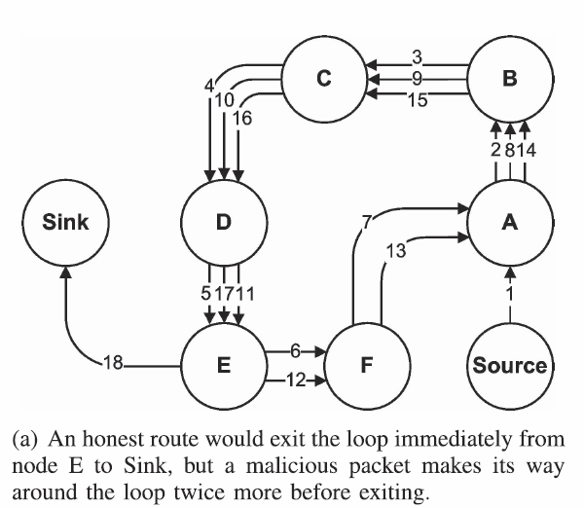
Introduction (cont’): Overview
Attacks that can target source routing
(a) Carousel attack:
adversary composes packets
with purposely introduced
routing loops
sends packets in circles
targets source routing protocols by exploiting the limited verification of message headers at forwarding nodes, allowing a single packet to repeatedly traverse the same set of nodes
Results show that in a randomly generated topology,
a single attacker can use a carousel attack to
increase energy consumption by as much
as a factor of 4

Slide 9
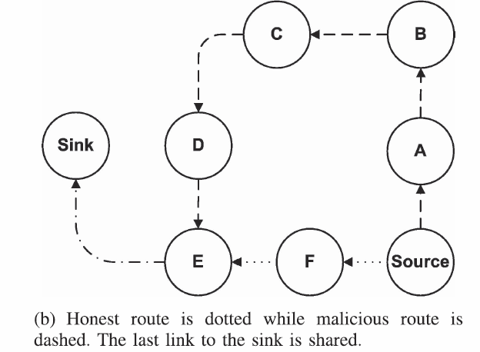
Introduction (cont’): Overview
Honest hop count = 3
Malicious hop count = 6
(b) Stretch attack:
An adversary constructs artificially long routes, potentially traversing every node in the network
Increases packet path lengths, causing packets to be processed by a number of nodes that is independent of hop count along the shortest path between the adversary and packet destination
stretch attacks increase energy usage
by up to an order of magnitude, depending
on the position of the malicious node
The impact of these attacks can be further increased by combining them, increasing the number of adversarial nodes in the network, or simply sending more packets

Slide 10
Related work
Power draining attacks have not been rigorously defined, evaluated, or mitigated at the routing layer.
Existing research:
“sleep deprivation torture.”
Resource exhaustion at the MAC and transport layers, but only offers rate limiting and elimination of insider adversaries
Switching away from source routing as a solution
SYN flood attack, wherein adversaries make multiple connection requests to a server, which will allocate resources for each connection request, eventually running out of resources. Solution: put more burden on the Client.

Slide 11
Attacks on Stateless Protocols
Includes source routing protocols (e.g. DSR):
source node specifies the entire route to a destination within the packet header, intermediate nodes rely on a route specified by the source.
burden is on the source to ensure that the route is valid at the time of sending
Evaluated both the carousel and stretch attacks in a randomly generated 30-node topology and a single randomly selected malicious DSR agent, using the ns-2 network simulator
attacks are carried out by a randomly selected adversary

Slide 12
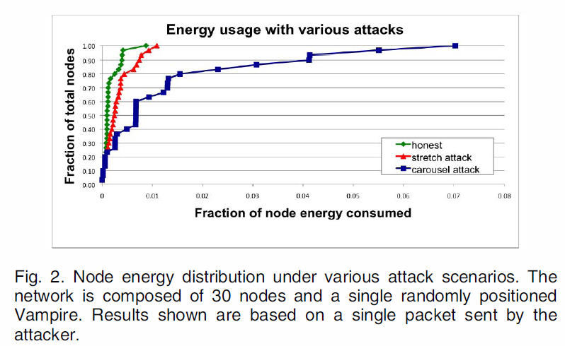
Attacks on Stateless Protocols (cont’)
Figure shows Per-node energy usage
carousel attack causes excessive
energy usage for a few nodes, since
only nodes along a shorter path
are affected
stretch attack shows more
uniform energy consumption for
all nodes in the network, since it
lengthens the route, causing more
nodes to process the packet

Slide 13
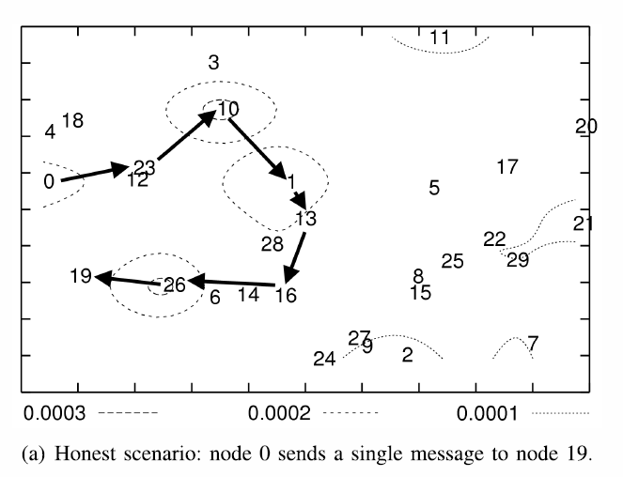
Attacks on Stateless Protocols (cont’)
Case only honest nodes :
Energy usage when node 0 sends a single packet to node 19 in an example network topology with only honest nodes. Black arrows denote the path
of the packet.

Slide 14
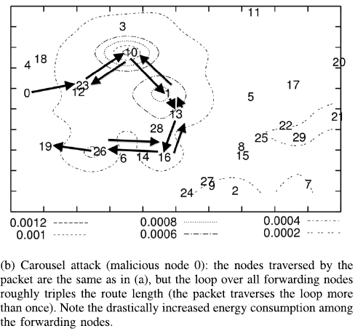
Attacks on Stateless Protocols (cont’)
Carousel Attack:
In this attack, an adversary sends a packet with a route composed as a series of loops, such that the same node appears in the route many times. This strategy can be used to increase the route length beyond the number of nodes in the network, only limited by the number of allowed entries in the source route
Malicious node 0 carries out a carousel
attack, sending a single message to node 19
(which does not have to be malicious). Note
the drastic increase in energy usage along the
original path. Assuming the adversary limits
the transmission rate to avoid saturating
the network, the theoretical limit of this
attack is an energy usage increase factor of
O(λ), where λ is the maximum route length.
The length of the adversarial path is a multiple
of the honest path, which is in turn, affected
by the position of the adversary in relation to
the destination

Slide 15
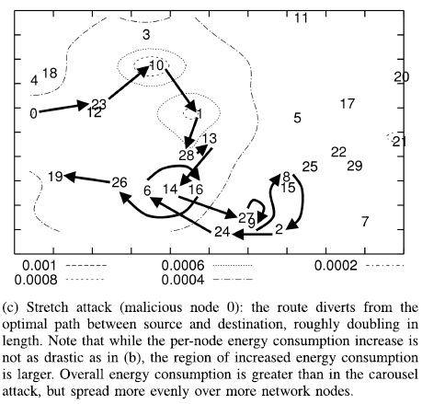
Attacks on Stateless Protocols (cont’)
Stretch attack (cont’) :
The theoretical limit of the stretch attack is a packet that traverses every network node, causing an energy usage increase of factor O(min(N,λ)), where N is the number of nodes in the network and λ is the maximum path length allowed.
This attack is potentially less damaging per packet than the carousel attack, as the number of hops per packet is bounded by the number of network nodes. However, adversaries can combine carousel and stretch attacks to keep the packet in the network longer: the resulting “stretched cycle” could be traversed repeatedly in a loop.
The position of the adversarial node affects the strength of the attack. Not all routes can be significantly lengthened, depending on the location of the adversary. Unlike the carousel attack, where the relative positions of the source and sink are important, the stretch attack can achieve the same effectiveness independent of the attacker’s network position relative to the destination.

Slide 16
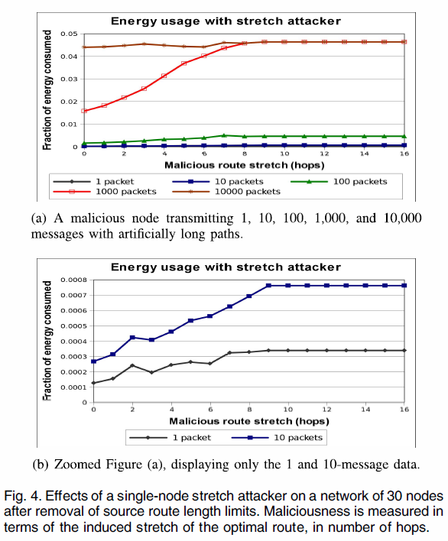
Attacks on Stateless Protocols (cont’)
Network links become
saturated at 10,000
messages per second
(even without the
stretch attack)
(Increasing maliciousness beyond nine has no effect due to the diameter of test topology.)
can achieve the same
effects by sending an
order of magnitude fewer
messages at
a stretch attack
maliciousness level
of 8 or greater
Effect still noticeable
With 1 and 10 packets
These attacks are less effective in
Hierarchical networks, where nodes
send messages to aggregators, who
in turn sends it to other aggregators.
Would need single adversary per
neighborhood to disable the network.

Slide 17
Attacks on Stateless Protocols (cont’)
Mitigation Methods:
Carousel attack:
Can be prevented entirely by having forwarding nodes check source
routes for loops; When a loop is detected, the source route could be corrected
and the packet sent on, but one of the attractive features of source routing
is that the route can itself be signed by the source. Therefore, it is better to simply drop the packet, especially considering that the sending node is likely malicious (honest nodes should not introduce loops).

Slide 18
Attacks on Stateless Protocols (cont’)
An alternate solution is to alter how intermediate nodes process the source route. To forward a message, a node must determine the next hop by locating itself in the source route. If a node searches for itself from the destination backward instead from the source forward, any loop that includes the current node will be automatically truncated (the last instance of the local node will be found in the source route rather than the first).
PATH containing loops:
0->23->…26->…23->…->26->19
Before 26 loops back it checks
Path in reverse,
and sends to
next node accordingly-> prevents
Looping, sends to 19 on next hop

Slide 19
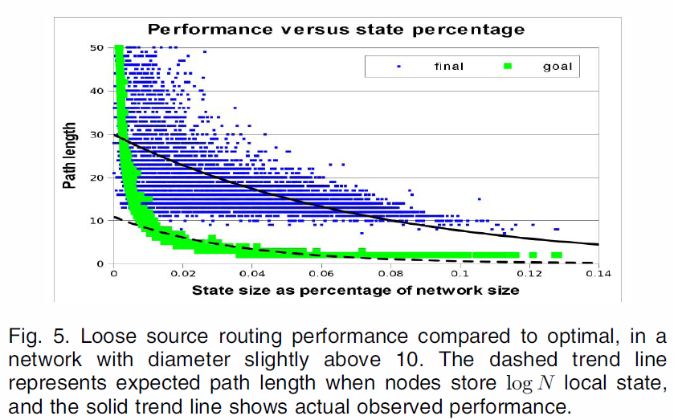
Attacks on Stateless Protocols (cont’)
Mitigation Methods:
Stretch attack :
If we call the no-optimization case “strict” source routing, since the route is followed exactly as specified in the header, we can define loose source routing, where intermediate nodes may replace part or all of the route in the packet header if they know of a better route to the destination
The amount of node-local storage required to achieve reasonable levels of mitigation approaches global topology knowledge, defeating the purpose of using source routing.
Paths are actually longer; Only a few
messages encountered a node with a better path to the destination than the originally assigned long source route.
Therefore conclude that loose source
routing is worse than keeping global state at every node
Other mentioned ideas:
can bound the damage of carousel
And stretch attackers by limiting
the allowed source route length
based on the expected maximum
path length in the
network
Existing algorithms assume
cooperation between nodes
- Cannot use
expected path length of rerouted packets if each node stores logN network paths

Slide 20
Attacks on Stateful Protocols
Routes in link-state and distance-vector networks are built dynamically from many independent forwarding decisions, so adversaries have limited power to affect packet forwarding, making these protocols immune to carousel and stretch attacks. (unlike DSR, no full path can be specified by a malicious source).
Directional antenna attack:
Using a directional antenna adversaries can deposit a packet in arbitrary parts of the network, while also forwarding the packet locally. This consumes the energy of nodes that would not have had to process the original packet, with the expected additional honest energy expenditure of O(d), where d is the network diameter, making d/2 the expected length of the path to an arbitrary destination from the furthest point in the network.

Slide 21
Attacks on Stateful Protocols (cont’)
Malicious discovery attack:
Another attack on all previously mentioned routing protocols (including stateful and stateless) is spurious route discovery. Possible to initiate a flood by sending a single message.
A malicious node has a number of ways to induce a perceived topology change: it may simply falsely claim that a link is down, or claim a new link to a nonexistent node.
two cooperating malicious nodes may claim the link between them is down. However, nearby nodes might be able to monitor communication to detect link failure
a single node can emulate multiple nodes in neighbor relationships, or falsely claim nodes as neighbors -> countermeasure is to use authentication.
two cooperating adversaries communicating through a wormhole could repeatedly announce and withdraw routes that use this wormhole, causing a theoretical energy usage increase of a factor of O(N) per packet
Coordinate and Beacon-Based Protocols: These protocols also fall victim to directional antenna attacks in the same way as link-state and distance-vector protocols above

Slide 22
Clean-Slate Sensor Network Routing
PLGP: a clean-slate secure sensor network routing protocol by Parno et al.
The original version of the protocol is vulnerable to Vampire attacks.
PLGP consists of a topology discovery phase, followed by a packet forwarding phase.
Discovery deterministically organizes nodes into a tree that will later be used as an addressing scheme
repeated on a fixed schedule
Discovery deterministically organizes nodes into a tree that will later be used as an addressing scheme
When discovery begins, each node has a limited view of the network—the node knows only itself. Nodes discover their neighbors using local broadcast, and form ever expanding “neighborhoods,” stopping when the entire network is a single group. Throughout this process, nodes build a tree of neighbor relationships and group membership that will later be used for addressing and routing.

Slide 23
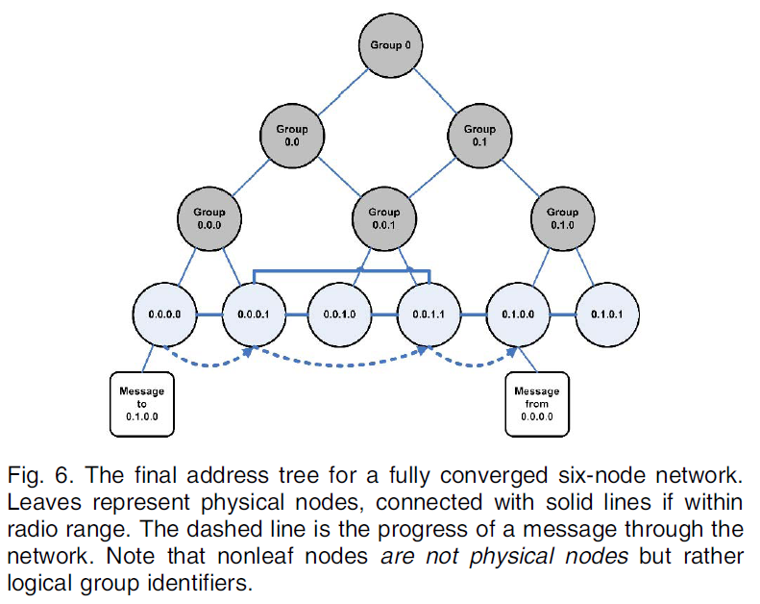
PLGP
At the end of discovery, each
node should compute the same
address tree as other nodes.
All leaf nodes in the tree are
physical nodes in the network,
and their virtual addresses
correspond to their position
in the tree

Slide 24
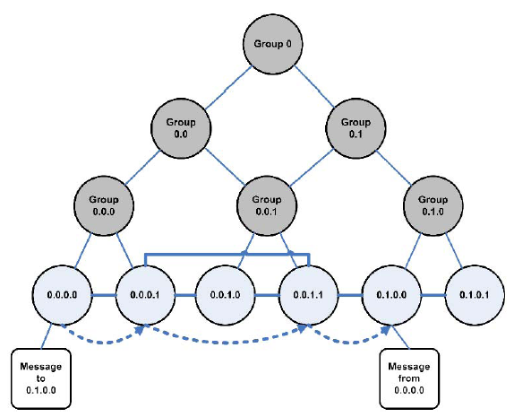
PLGP(cont’): Forming groups and addressing
Each node starts as its own group of size one, with a virtual address 0. Nodes
who overhear presence broadcasts form groups with their
neighbors. When two individual nodes (each with an initial
address 0) form a group of size two, one of them takes the
address 0, and the other becomes 1
Like individual nodes, each group will initially
choose a group address 0, and will choose 0 or 1
when merging with another group. Each group
member prepends the group address to their own
address, e.g., node 0 in group 0 becomes 0.0,
node 0 in group 1 becomes 1.0, and so on.
Each time two groups merge, the address of
each node is lengthened by 1 bit. Implicitly,
this forms a binary tree of all addresses in
the network, with node addresses as leaved.

Slide 25
PLGP(cont’): Forming groups and addressing
When larger groups merge, they both broadcast their group IDs (and the IDs of all group members) to each other, and proceed with a merge protocol identical to the two-node case
Groups that have grown large enough that some members are not within radio range of other groups will communicate through “gateway nodes,” which are within range of both groups.
every node within a group will end up with a next-hop path to every other group, as in distance vector. Topology discovery proceeds in this
manner until all network nodes are members of a single group. By the end of topology discovery, each node learns every other node’s virtual address, public key, and certificate, since every group members knows the identities of all other group members and the network converges to a
single group.

Slide 26
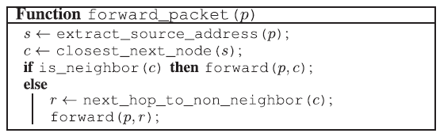
PLGP(cont’): Forming groups and addressing
Packet forwarding. During the forwarding phase, all decisions are made independently by each node. When receiving a packet, a node determines the next hop by finding the most significant bit of its address that differs from the message originator’s address .
Thus, every forwarding event (except when a packet is moving within a group in order to reach a gateway node to proceed to the next group) shortens the logical distance to the destination, since node addresses should be strictly closer to the destination

Slide 27
PLGP(cont’): Forwarding
In PLGP, forwarding nodes do not know what path a packet took, allowing adversaries to divert packets to any part of the network, even if that area is logically further away from the destination than the malicious node. This
makes PLGP vulnerable to Vampire attacks
An honest node has no way to tell that the packet it just received is moving away from the destination; the only information available to the honest node is its own address and the packet destination address, but not the address of the previous hop (who can lie).

Slide 28
Provable Security against Vampire Attacks
No-backtracking property:
Satisfied for a given packet if and only if it consistently makes progress toward its destination in the logical network address space.
More formally:
No-backtracking is satisfied if every packet p traverses the same number of hops whether or not an adversary is present in the network.
Case 1: L is honest
L
…(hops) …
D
Case 2: L is Malicious
L
…(hops) …
D
Same # of Hops
Same network wide energy utilization
is independent of the actions of malicious nodes
No-backtracking implies Vampire resistance

Slide 29
Provable Security against Vampire Attacks (cont’)
PLGP does not satisfy No-backtracking property:
PLGP differs from other protocols in that packets paths are further bounded by a tree, forwarding packets along the shortest route through the tree that is allowed by the physical topology. Since the tree implicitly mirrors the topology (two nodes have the same parent if and only if they are physical neighbors, and two nodes sharing an ancestor have a network path to each other), and since every node holds an identical copy of the address tree, every node can verify the optimal next logical hop.
However, this is not sufficient for no-backtracking to hold, since nodes cannot be
certain of the path previously traversed by a packet.
Adversaries can always lie about their local metric, and so PLGP is still vulnerable
to directional antenna/wormhole attacks, which allow adversaries to divert packets
to any part of the network.

Slide 30
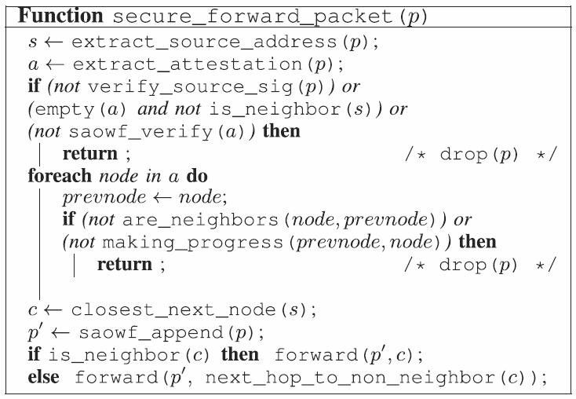
Provable Security against Vampire Attacks (cont’)
Propose PLGP with attestations (PLGPa):
Add a verifiable path history to every PLGP packet
The resulting protocol, PLGP with attestations (PLGPa) uses this packet history together with PLGP’s tree routing structure so every node can securely verify progress, preventing any significant adversarial influence on the path taken by any packet which traverses at least one honest node.
These signatures form a chain attached to every packet, allowing any node receiving it to validate its path. Every forwarding node verifies the attestation chain to ensure that the packet has never traveled away from its destination in the logical address space.
packet forwarding for PLGPa

Slide 31
Provable Security against Vampire Attacks (cont’)
PLGPa satisfies no-backtracking
Since all messages are signed by their originator, messages from honest nodes cannot be arbitrarily modified by malicious nodes wishing to remain undetected. Rather, the adversary can only alter packet fields that are changed en route (and so are not authenticated), so only the route attestation field can be altered, shortened, or removed entirely.
To prevent truncation, which would allow Vampires to hide the fact that they are moving a packet away from its destination, use one-way signature chain construction which allow nodes to add links to an existing signature chain, but not remove links, making attestations append only.

Slide 32
Provable Security against Vampire Attacks (cont’)
PLGPa satisfies no-backtracking (cont’)
so we define the hop count of a packet as follows:
Definition. The hop count of packet p, received or forwarded by an honest node, is no greater than the number of entries in p’s route attestation field, plus 1.
When any node receives a message, it checks that every node in the path attestation 1) has a corresponding entry in the signature chain, and 2) is logically closer to the destination than the previous hop in the chain. This way, forwarding nodes can enforce the forward progress of a message, preserving no-backtracking.
If no attestation is present, the node checks to see if the originator of the message is a physical neighbor. Since messages are signed with the originator’s key, malicious nodes cannot falsely claim to be the origin of a message, and therefore do not benefit by removing attestations.
Theorem 1. A PLGPa packet p satisfies no-backtracking in the presence of an adversary controlling m < N - 3 nodes if p passes through at least one honest node.

Slide 33
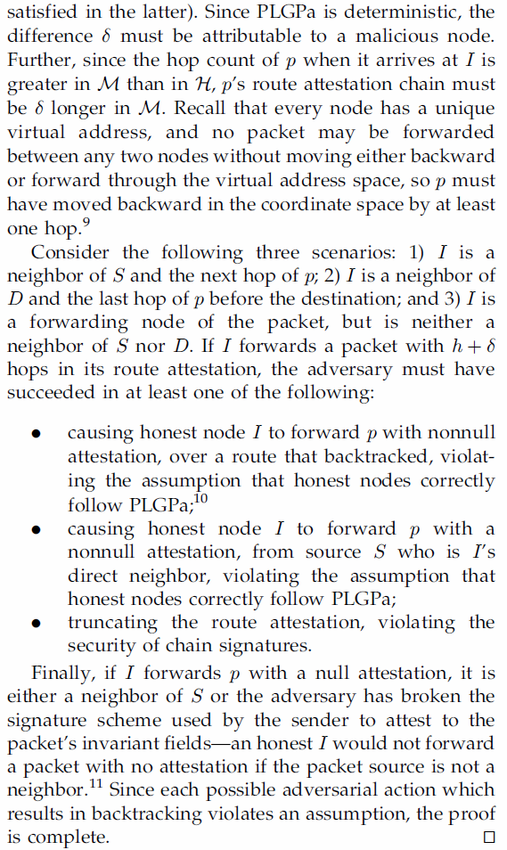
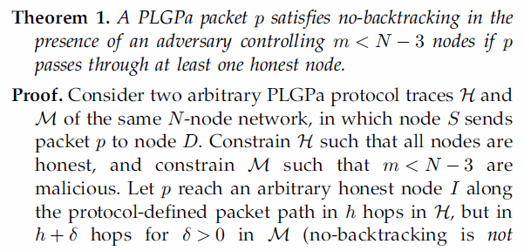
Proof PLGPa
Proof:
….Since each possible adversarial action which results in backtracking violates an assumption, the proof is complete

Slide 34
Provable Security against Vampire Attacks (cont’)
Since no-backtracking guarantees packet progress, and
PLGPa preserves no-backtracking, it is the only protocol
discussed so far that provably bounds the ratio of energy
used in the adversarial scenario to that used with only honest
nodes to 1, and by the definition of no-backtracking PLGPa
resists Vampire attacks.
This is achieved because packet progress is securely verifiable.
Can modify to allow for limited backtracking (-backtracking, as opposed to original 0-backtracking scheme), which provides some leeway in the way no-backtracking is verified, allowing a certain amount of total backtracking per packet within a security parameter (Case of reaching a dead-end path).

Slide 35
Performance Considerations
PLGPa includes path attestations which increase the size of every packet, incurring penalties in terms of bandwidth use, and thus radio power. Adding extra packet verification requirements for intermediate nodes also increases processor utilization, requiring time, and additional power.
There is nothing to be gained in completely nonadversarial environments, but in the presence of even a small number of malicious nodes, the increased overhead becomes worthwhile when considering the potential damage of Vampire attacks.
In total, the overhead on the entire network of PLGPa (over PLGP) when using 32-bit processors or dedicated cryptographic accelerator is the energy equivalent of 90 additional bytes per packet, or a factor O(xλ), where λ is the path length between source and destination and x is 1.2-7.5, depending on average packet size (512 and 12 bytes, respectively).
Even without dedicated hardware, the cryptographic computation required for PLGPa is tractable even on 8-bit processors, although with up to a factor of 30 performance penalty, but this hardware configuration is increasingly uncommon.

Slide 36
Securing the Discovery Phase
Enforce rate limits in a number of ways, such as neighbor throttling or one-way hash chains [14]. We can also optimize discovery algorithms to minimize our window of vulnerability. If a network survives the high risk discovery period, it is unlikely to suffer serious damage from Vampires during normal packet forwarding.
An attack in discovery phase:
Malicious nodes can use directional antennas to masquerade neighbors to any or all nodes in the network, and therefore look like a group of size one, with which other groups will try to preferentially merge. Merge requests are composed of the requested group’s ID as well as all the group members’ IDs, and the receiving node will flood this request to other group members.
Other groups will issue merge requests, which the Vampire can deny. In PLGP, denials are only allowed if another merge is in progress, so if we modify the reject message to include the ID of the group with which the merge is in progress (and a signature for nonrepudiation), these messages can be kept and replayed at the end of the topology discovery period, detecting and removing nodes who incorrectly deny merge requests. Vampires could maintain the illusion that it is a neighbor of a given group. Since join events require multiparty computation and are flooded throughout the group, this makes for a fairly effective attack
The bound we can place on malicious discovery damage in PLGPa is still unknown. Moreover, if we can conclude that a single malicious node causes a factor of k energy increase during discovery (and is then expelled), it is not clear how that value scales under collusion among multiple malicious nodes.

Slide 37
Conclusion
Authors defined Vampire attacks, a new class of resource consumption attacks that use routing protocols to permanently disable ad hoc wireless sensor networks by depleting nodes’ battery power. These attacks do not depend on particular protocols or implementations, but rather expose vulnerabilities in a number of popular protocol classes.
They showed a number of proof-of-concept attacks against representative examples of existing routing protocols using a small number of weak adversaries, and measured their attack success on a randomly generated topology of 30 nodes. Simulation results show that depending on the location of the adversary, network energy expenditure during the forwarding phase increases from between 50 to 1,000 percent. Theoretical worst case energy usage can increase by as much as a factor of O(N) per adversary per packet, where N is the network size.
Authors proposed defenses against some of the forwarding-phase attacks and described PLGPa, the first sensor network routing protocol that provably bounds damage from Vampire attacks by verifying that packets consistently make progress toward their destinations.
Authors have not offered a fully satisfactory solution for Vampire attacks during the topology discovery phase, but suggested some intuition about damage limitations possible with further modifications to PLGPa.

